Slide 1
Murach’s C# (8th Edition)
Chapter 12
How to create and use classes

Slide 2
Objectives
Applied
Given the specifications for an app that uses classes, structures, records, or record structs, develop the app.
Knowledge
List and describe the three layers of a three-layered application.
Describe these members of a class: constructor, method, and property.
Describe the concept of encapsulation.
Explain how instantiation works.
Describe the main advantage of using object initializers.
Explain how auto-implemented properties work and how they differ from properties that use a private field.

Slide 3
Objectives (continued)
Explain how expression-bodied methods, constructors, properties, and accessors work.
Explain what a static member is.
Describe the concept of overloading a method or constructor.
Explain what a required property is.
Describe the use of property patterns with objects.
Describe the difference between a class, a structure, a record and a record struct.

Slide 4
The architecture of a three-layered app
Presentation layer (form classes)
Middle layer (business classes)
Database layer (database access classes)

Slide 5
The code for the Product class
namespace ProductMaintenance
{
public class Product
{
// a constructor
public Product() { }
// three public properties
public string Code { get; set; } = "";
public string Description { get; set; } = "";
public decimal Price { get; set; }
// a public method
public string GetDisplayText(string sep) =>
$"{Code}{sep}{Price.ToString("c")}
{sep}{Description}";
}
}

Slide 6
Class and object concepts
An object is a self-contained unit that has properties, methods, and other members.
A class contains the code that defines the members of an object.
An object is an instance of a class, and the process of creating an object is called instantiation.
Encapsulation is one of the fundamental concepts of object-oriented programming.
The data of a class is typically encapsulated within a class using data hiding.

Slide 7
Code that declares and creates two Product objects
Product product1 = new Product();
product1.Code = "C#";
product1.Description = "Murach's C#";
product1.Price = 59.50m;
Product product2 = new(); // C# 9.0 and later
product2.Code = "ASPMVC";
product2.Description = "Murach's ASP.NET MVC";
product2.Price = 61.50m;

Slide 8
Code that declares and creates an object with an object initializer
Product product1 = new() { // C# 9.0 and later
Code = "C#",
Description = "Murach's C#",
Price = 59.50m
};

Slide 9
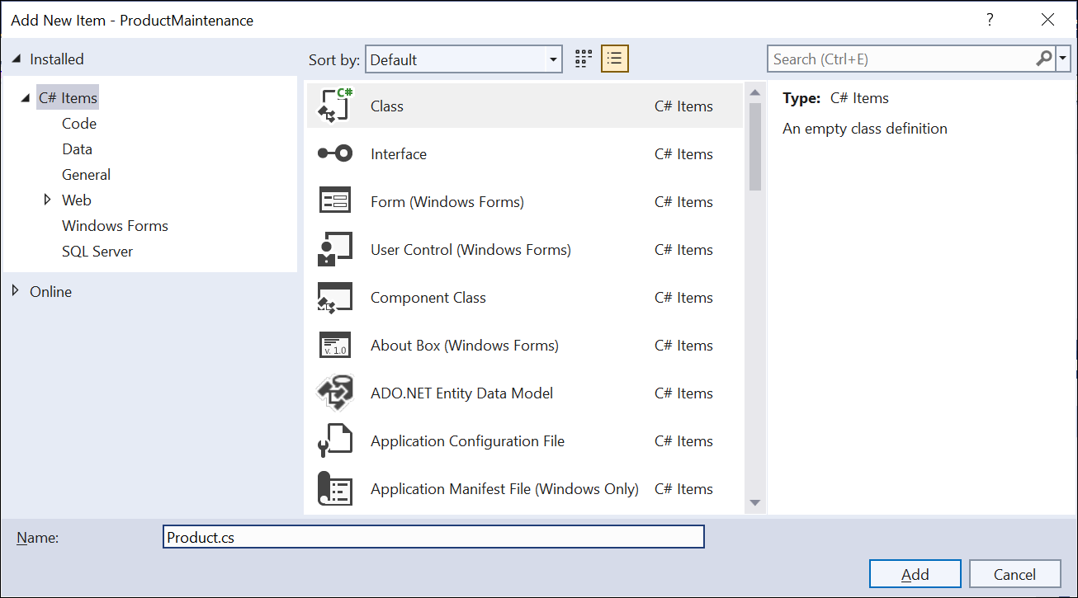
The dialog for adding a class

Slide 10
The starting code for a new class
using System;
using System.Collections.Generic;
using System.Linq;
using System.Text;
using System.Threading.Tasks;
namespace ProductMaintenance
{
internal class Product
{
}
}

Slide 11
Getting and setting the value of a property
A statement that sets the value of a property
product.Code = txtProductCode.Text;
A statement that gets the value of a property
string code = product.Code;

Slide 12
A read-only property with a getter and an initial value
public string Code { get; } = "C#";
The same read-only property coded with an expression body
public string Code => "C#";

Slide 13
A property with an init-only setter (C# 9.0 and later)
public string Code { get; init; };
A statement that uses an object-initializer to set the init-only property
Product product2 = new() { Code = "C#" };

Slide 14
A method that accepts parameters
public string GetDisplayText(string sep)
{
return $"{Code}{sep}{Price.ToString("c")}{sep}
{Description}";
}
The same method coded with an expression body
public string GetDisplayText(string sep) =>
$"{Code}{sep}{Price.ToString("c")}{sep}{Description}";

Slide 15
Constructors with and without parameters
A constructor with no parameters
public Product()
{
}
A constructor with three parameters
public Product(string code, string description,
decimal price)
{
this.Code = code;
this.Description = description;
this.Price = price;
}

Slide 16
Statements that call these constructors
Product product1 = new Product();
Product product2 = new(); // C# 9.0 and later
Product product3 = new Product("C#","Murach's C#",59.50m);
Product product4 = new("C#", "Murach's C#", 59.50m); // C# 9.0 and later

Slide 17
A constructor with an expression body (C# 7.0 and later)
public Product(string code) => this.Code = code;
A constructor with an expression body and a tuple (C# 7.0 and later)
public Product(string code, string description,
decimal price) =>
(this.Code, this.Description, this.Price) =
(code, description, price);

Slide 18
A class that contains static members
public static class Validator
{
public static string LineEnd { get; set; } = "\n";
public static string IsPresent(
string value, string name)
{
string msg = "";
if (value == "")
{
msg = $"{name} is a required field.{LineEnd}";
}
return msg;
}
}

Slide 19
Code that uses static members
string errorMessage = "";
errorMessage += Validator.IsPresent( txtCode.Text, nameof(Product.Code));
errorMessage += Validator.IsPresent( txtDescription.Text, nameof(Product.Description));
if (errorMessage != "")
{
MessageBox.Show(errorMessage, "Entry Error");
}

Slide 20
A using directive for the static Validator class
using static ProductMaintenance.Validator;

Slide 21
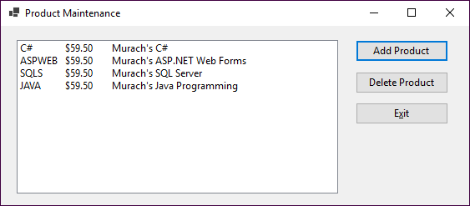
The Product Maintenance form

Slide 22
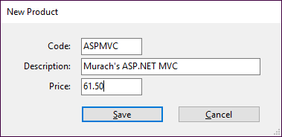
The New Product form

Slide 23
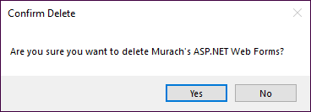
The Confirm Delete dialog

Slide 24
The code for the Product Maintenance form (part 1)
public partial class frmProductMain : Form
{
public frmProductMain()
{
InitializeComponent();
}
private List<Product> products = null!;
private void frmProductMain_Load(object sender, EventArgs e)
{
products = ProductDB.GetProducts();
FillProductListBox();
}
private void FillProductListBox()
{
lstProducts.Items.Clear();
foreach (Product p in products) {
lstProducts.Items.Add(p.GetDisplayText("\t"));
}
}

Slide 25
The Product Maintenance code (part 2)
private void btnAdd_Click(object sender, EventArgs e)
{
frmNewProduct newProductForm = new();
Product product = newProductForm.GetNewProduct();
if (product != null)
{
products.Add(product);
ProductDB.SaveProducts(products);
FillProductListBox();
}
}
private void btnDelete_Click(object sender, EventArgs e)
{
int i = lstProducts.SelectedIndex;
if (i != -1)
{
Product product = products[i];
string message = "Are you sure you want to delete "
+ product.Description + "?";

Slide 26
The Product Maintenance code (part 3)
DialogResult button =
MessageBox.Show(message, "Confirm Delete",
MessageBoxButtons.YesNo);
if (button == DialogResult.Yes)
{
products.Remove(product);
ProductDB.SaveProducts(products);
FillProductListBox();
}
}
}
private void btnExit_Click(object sender, EventArgs e)
{
this.Close();
}
}

Slide 27
The code for the New Product form (part 1)
public partial class frmNewProduct : Form
{
public frmNewProduct()
{
InitializeComponent();
}
private Product product = null!;
public Product GetNewProduct()
{
this.ShowDialog();
return product;
}

Slide 28
The code for the New Product form (part 2)
private void btnSave_Click(object sender, EventArgs e)
{
if (IsValidData())
{
product = new()
{
Code = txtCode.Text,
Description = txtDescription.Text,
Price = Convert.ToDecimal(txtPrice.Text)
};
this.Close();
}
}

Slide 29
The code for the New Product form (part 3)
private bool IsValidData()
{
bool success = true;
string errorMessage = "";
errorMessage += Validator.IsPresent(txtCode.Text,
nameof(Product.Code));
errorMessage += Validator.IsPresent(txtDescription.Text,
nameof(Product.Description));
errorMessage += Validator.IsDecimal(txtPrice.Text,
nameof(Product.Price));
if (errorMessage != "")
{
success = false;
MessageBox.Show(errorMessage, "Entry Error");
}
return success;
}
private void btnCancel_Click(object sender, EventArgs e)
{
this.Close();
}
}

Slide 30
The code for the Validator class
public static class Validator
{
public static string LineEnd { get; set; } = "\n";
public static string IsPresent(string value, string name)
{
string msg = "";
if (value == "")
{
msg = $"{name} is a required field.{LineEnd}";
}
return msg;
}
public static string IsDecimal(string value, string name)
{
string msg = "";
if (!Decimal.TryParse(value, out _))
{
msg = $"{name} must be a valid decimal value.{LineEnd}";
}
return msg;
}

Slide 31
The code for the Validator class (continued)
public static string IsInt32(string value, string name) {
string msg = "";
if (!Int32.TryParse(value, out _))
{
msg = $"{name} must be a valid integer value.{LineEnd}";
}
return msg;
}
public static string IsWithinRange(string value, string name,
decimal min, decimal max) {
string msg = "";
if (Decimal.TryParse(value, out decimal number))
{
if (number < min || number > max)
{
msg = $"{name} must be between {min} and {max}.{LineEnd}";
}
}
return msg;
}
}

Slide 32
A getter that processes the field value before returning it
private string code;
public string Code
{
get
{
if (String.IsNullOrEmpty(code))
return "N/A";
else
return code;
}
set => code = value;
}

Slide 33
A setter that processes the field value before setting it
private string code;
public string Code
{
get => code;
set
{
if (String.IsNullOrEmpty(value))
value = "N/A";
code = value;
}
}

Slide 34
How to code overloaded methods
The GetDisplayText() method of the Product class
public string GetDisplayText(string sep) =>
$"{Code}{sep}{Price.ToString("c")}{sep}{Description}";
An overloaded version of the GetDisplayText() method
public string GetDisplayText() => GetDisplayText(", ");
Two statements that call the GetDisplayText() method
lblProduct.Text = product.GetDisplayText("\t");
lblProduct.Text = product.GetDisplayText();

Slide 35
How to code overloaded constructors
A constructor of the Product class with no parameters
public Product() { }
A constructor of the Product class with three parameters
public Product(string code, string description,
decimal price)
{
this.Code = code;
this.Description = description;
this.Price = price;
}

Slide 36
A Product class with three required properties
public class Product
{
public required string Code { get; set; }
public required string Description { get; set; }
public required decimal Price { get; set; }
...
}

Slide 37
How to use the SetsRequiredMembers attribute
using System.Diagnostics.CodeAnalysis;
...
public class Product
{
public Product() { }
[SetsRequiredMembers]
public Product(string code, string description,
decimal price)
{
Code = code;
Description = description;
Price = price;
}
public required string Code { get; set; }
public required string Description { get; set; }
public required decimal Price { get; set; }
...
}

Slide 38
Nested if statements that test an object’s type and property value
private static decimal GetDiscountPercent(Object o)
{
decimal discountPercent = .0m;
if (o is Product p)
{
if (p.Category == ".NET")
discountPercent = .1m;
else if (p.Category == "Java")
discountPercent = .2m;
}
return discountPercent;
}

Slide 39
A switch statement that tests an object’s type and property value
private static decimal GetDiscountPercent(Object o)
{
switch (o)
{
case Product p when p.Category == ".NET":
return .1m;
case Product p when p.Category == "Java":
return .2m;
default:
return .0m;
}
}

Slide 40
A switch expression that uses a property pattern to test an object’s type and property value
private static decimal GetDiscountPercent(Object o) =>
o switch
{
Product { Category: ".NET" } => .1m,
Product { Category: "Java" } => .2m,
_ => .0m
};

Slide 41
A method that tests two types of objects
private static decimal GetDiscountPercent(Object o) =>
o switch
{
Product { Category: ".NET" } => .1m,
Product { Category: "Java" } => .2m,
Product { Category: "Web" } => .3m,
Product { Category: "Mainframe"} => .4m,
Vendor { DiscountType: "Quantity"} => .2m,
Vendor { DiscountType: "Terms", Terms: 30 } => .3m,
_ => .0m
};

Slide 42
A method that tests a specific type of object
private static decimal GetDiscountPercent(Product p) =>
p switch
{
{ Category: ".NET" } => .1m,
{ Category: "Java" } => .2m,
_ => .0m
};

Slide 43
How to refer to a nested property in a property pattern
Prior to C# 10.0
private static decimal GetTaxPercent(Object o) => o switch
{
Vendor { State: { StateCode: "CA" } } => 7.5m,
Vendor { State: { StateCode: "NY" } } => 6m,
...
_ => .0m
};
C# 10.0 and later
private static decimal GetTaxPercent(Object o) => o switch
{
Vendor { State.StateCode: "CA" } => 7.5m,
Vendor { State.StateCode: "NY" } => 6m,
...
_ => .0m
};

Slide 44
A Product structure
public struct Product
{
public Product(string code, string description,
decimal price)
{
this.Code = code;
this.Description = description;
this.Price = price;
}
public string Code { get; set; }
public string Description { get; set; }
public decimal Price { get; set; }
public string GetDisplayText(string sep) =>
$"{Code}{sep}{Price.ToString("c")}{sep}{Description}";
}

Slide 45
A read-only Product structure (C# 7.2 and later)
public readonly struct Product
{
public Product(string code, string description,
decimal price) {...}
public string Code { get; }
public string Description { get; }
public decimal Price { get; }
public string GetDisplayText(string sep) =>
$"{Code}{sep}{Price.ToString("c")}{sep}{Description}";
}

Slide 46
Code that works with an instance of a structure type
// Create an instance of the Product structure
// using the default constructor
Product p = new();
// Assign values to each property
p.Code = "C#";
p.Description = "Murach's C#";
p.Price = 59.50m;
// Call a method
string msg = p.GetDisplayText("\n");

Slide 47
Code that initializes properties
With a constructor
Product p = new("C#", "Murach's C#", 59.50m);
With an object initializer
Product p = new() {Code="C#",Description="Murach's C#",
Price = 59.50m};

Slide 48
Code that creates and compares two structures
Product p1 = new("C#", "Murach's C#", 59.50m);
Product p2 = new("C#", "Murach's C#", 59.50m);
bool isEqual = p1.Equals(p2); // isEqual is true
p2.Price = 61.50m;
isEqual = p1.Equals(p2); // isEqual is false

Slide 49
Code that copies a structure and changes a value
Product product = new("C#", "Murach's C#", 59.50m);
Product copy = product;
copy.Price = 61.50m;

Slide 50
A Product record
public record Product
{
public Product(string code, string description,
decimal price) {...}
public string Code { get; set; }
public string Description { get; set; }
public decimal Price { get; set; }
public string GetDisplayText(string sep) =>
$"{Code}{sep}{Price.ToString("c")}{sep}{Description}";
}

Slide 51
Code that creates and compares two record instances
Product p1 = new("C#", "Murach's C#", 59.50m);
Product p2 = new("C#", "Murach's C#", 59.50m);
bool isEqual = p1.Equals(p2); // isEqual is true
p2.Price = 61.50m;
isEqual = p1 == p2; // isEqual is false

Slide 52
A read-only Product record
public record Product(string Code, string Description,
decimal Price);

Slide 53
Code that copies an instance of a read-only record and changes a value
Product product = new("C#", "Murach's C#", 59.50m);
By passing the values of the original to the constructor of the copy
Product copy1 =
new(product.Code, product.Description, 61.50m);
By using the with keyword
Product copy2 = product with { Price = 61.50m };

Slide 54
A Product record struct
public record struct Product
{
public Product(string code, string description,
decimal price) {...}
public string Code { get; set; }
public string Description { get; set; }
public decimal Price { get; set; }
public string GetDisplayText(string sep) =>
$"{Code}{sep}{Price.ToString("c")}{sep}{Description}";
}

Slide 55
Code that creates and compares two record struct instances
Product p1 = new("C#", "Murach's C#", 59.50m);
Product p2 = p1; // makes a copy
bool isEqual = p1.Equals(p2); // isEqual is true
p2.Price = 61.50m; // changes p2 but not p1
isEqual = p1 == p2; // isEqual is false

Slide 56
A read-only Product record struct
public readonly record struct Product(string Code,
string Description, decimal Price);

Slide 57
When to use classes, structures, records, and record structs
Use a class when your object is complex, has many methods, or you need to create a hierarchy.
Use a structure when your object primarily stores data and is small enough to copy efficiently.
Use a record when your object primarily stores data and is small enough to copy efficiently.
Use a record struct when your object primarily stores data, is small enough to copy efficiently, and you want improved equality comparison features and performance.

Slide 58
The Product Maintenance app with a record
The Product record
public record Product(string Code, string Description,
decimal Price)
{
public string GetDisplayText() => GetDisplayText(", ");
public string GetDisplayText(string sep) =>
$"{Code}{sep}{Price.ToString("c")}{sep}{Description}";
}
The Save button event handler for the New Product form
private void btnSave_Click(object sender, EventArgs e)
{
if (IsValidData())
{
product = new(txtCode.Text, txtDescription.Text,
Convert.ToDecimal(txtPrice.Text));
this.Close();
}
}

Slide 59
The Product Maintenance app (continued)
The Add button event handler for the Maintenance form
private void btnAdd_Click(object sender, EventArgs e)
{
frmNewProduct newProductForm = new();
Product product = newProductForm.GetNewProduct();
if (product != null)
{ if (products.Contains(product)) {
MessageBox.Show(
"A product with values " +
product.GetDisplayText() +
" is already in list.", "Unable to add");
}
else {
products.Add(product);
ProductDB.SaveProducts(products);
FillProductListBox();
}
}
}

